Slide 1
Family Dynamics
Roles in Dysfunctional Families

Slide 2
Dependent Person
Role…
  The user is the source of the problem.
  User abuses alcohol/drugs to cover up negative feelings…(pain, fear, guilt etc.)
Behaviors (Common in User’s)
› Perfectionist, aggressive, charming, or rigid.

Slide 3
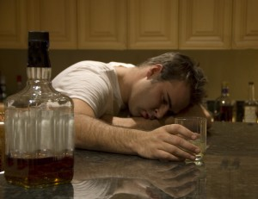

Slide 4
Chief Enabler
Role:
  Responsibility- Keep the family functioning;
  Tries to keep the family together by taking care of the abuser.
  Take on extra responsibilities within the family
  Enabler’s hide their own feelings & make it easy for the “user” to continue their chemical abuse.

Slide 5


Slide 6
Family Hero
Role:
  Provides family with a feeling of “worth”
The hero works hard for approval & “escapes” through involvement in a variety of activities outside the family
May be “super responsible & successful” on the outside but… lonely, hurt & inadequate on the inside.

Slide 7


Slide 8
Scapegoat
Role:
  Provides a distraction & takes a lot of the blame
  Scapegoats react negatively in response to the user in the family.
  May even be defiant or become chemical abusers themselves.
  Internalize their own feelings & act out in order to distract from the real problem…

Slide 9
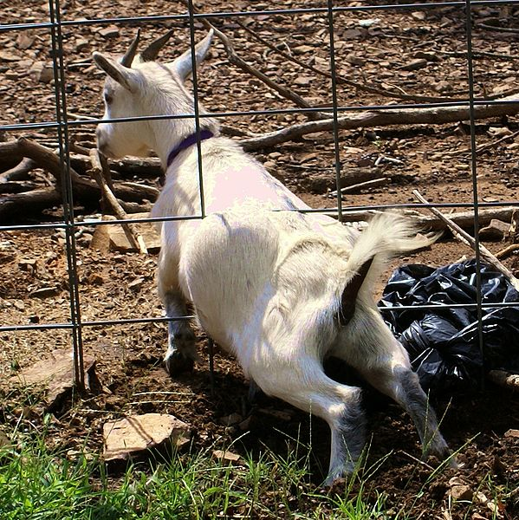

Slide 10
Mascot
Role:
  Provides relief through humor
Will do anything to attract attention…
Use humor & fun as a method to cope & distract from the problems created by the “user.”

Slide 11
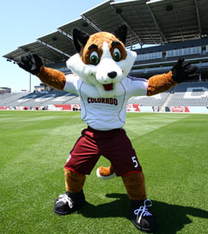

Slide 12
Lost Child
Role:
  Seeks relief by withdrawing…Would be the family member most prone to suicide.
Distance themselves from the user/family & the outside world.
May seek refuge from their family problems by being super-independent, withdrawn, quiet or overweight.

Slide 13


Slide 14
REVIEW

